Slide 1
Semi-Supervised Learning
By Yaohang Li, Ph.D. Department of Computer Science Old Dominion University yaohang@cs.odu.edu

Slide 2
Agenda
Data and Labels
Semi-supervised Learning
How can it work?
Assumptions
Semi-supervised Learning Methods
Self Training
Clustering and Label
Co-training
Gaussian Mixture
Graph-based Methods
Semi-Supervised Learning GAN
Semi-supervised Learning Applications
Summary

Slide 3
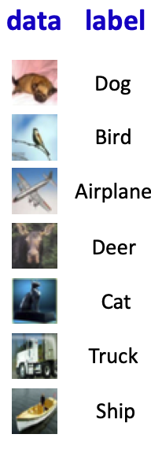
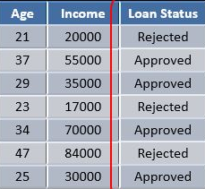
Labeled Data
Data Label
An annotation identifying certain properties, characteristics, or classifications
Labeled data
Data samples tagged with one or more labels

Slide 4
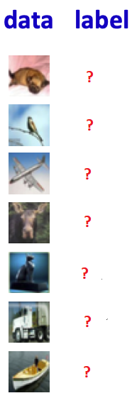
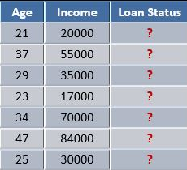
Unlabeled Data
Data without labels
Not tagged with any labels
Generated by the nature
Human created

Slide 5
Labeled Data vs. Unlabeled Data
Labeled data is often hard to get
Human annotation is boring and time consuming
Labels may require experts
Labels may require special devices
Sometimes data labels are unreliable
Limited and expensive
In contrast, unlabeled data is easy to get
Abundant
Easy to obtain

Slide 6
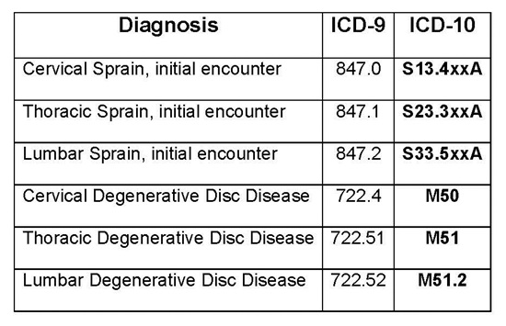
Example of Hard-to-Get Labels
Ninth Revision of International Classification of Diseases (ICD-9)
Official system of assigning codes to diagnoses and procedures associated with hospital utilization
Assigned to medical records
Required expert knowledge
Medicine
Coding rules
Medical terminologies
Automated ICD-9 coding via a deep learning approach, M Li, Z Fei, M Zeng, FX Wu, Y Li, Y Pan, J Wang, IEEE/ACM transactions on computational biology and bioinformatics 16 (4), 2018.

Slide 7
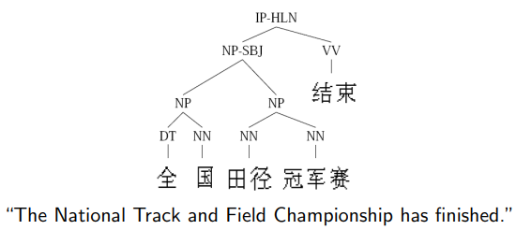
Example of Hard-to-Get Labels
Telephone Conversation Transcription
One hour of speech -> 400 hours annotation time
Natural Language Parsing
4,000 sentences -> 2 years annotation
ImageNet
2.5 years of human annotating 3.2M images
Example Credit: Xiaojin Zhu

Slide 8
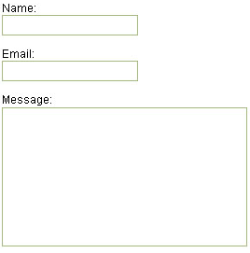
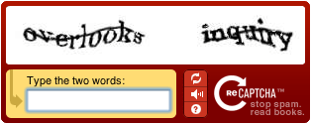
Free-of-Cost Labels
Luis von Ahn: Games with a purpose (ReCaptcha)
Word challenges to OCR
(Optical Character Recognition)
You provide a free label

Slide 9
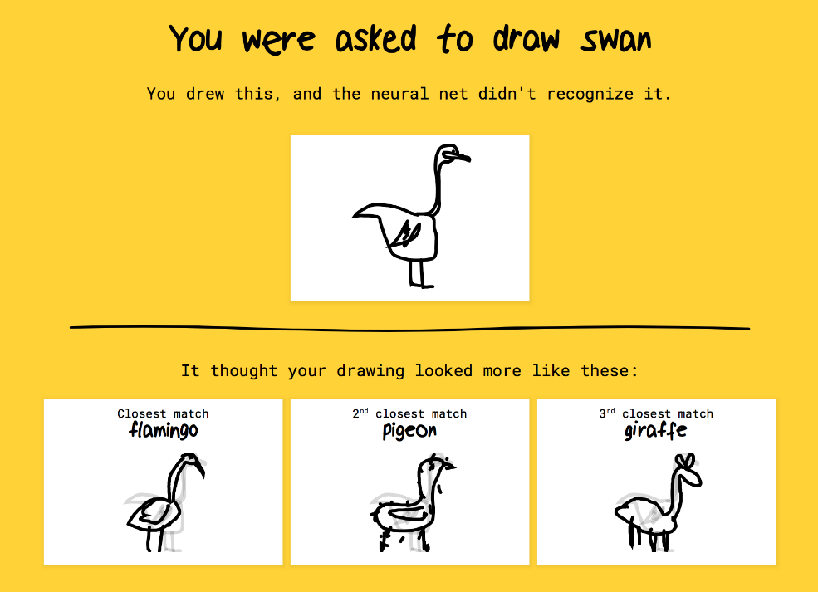

Free-of-Cost Label
Quick Draw

Slide 10
Agenda
Data and Labels
Semi-supervised Learning
How can it work?
Assumptions
Semi-supervised Learning Methods
Self Training
Clustering and Label
Co-training
Gaussian Mixture
Graph-based Methods
Semi-Supervised Learning GAN
Semi-supervised Learning Applications
Summary

Slide 11
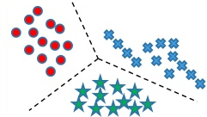
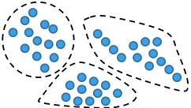
Types of Learning
Supervised learning
Given: training data + labels
Unsupervised learning
Given: training data (without labels)
Require Sufficient Labeled Data
Limited Capability

Slide 12
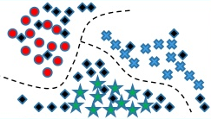
Semi-supervised Learning
Semi-supervised Learning
Use both labeled and unlabeled data to build better machine learning models

Slide 13
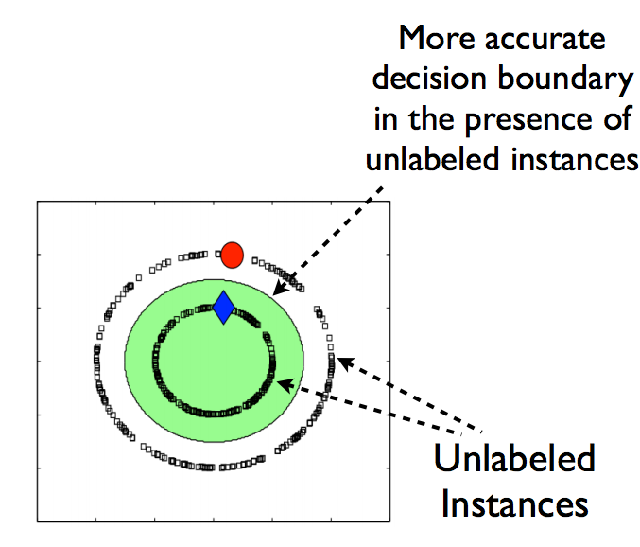
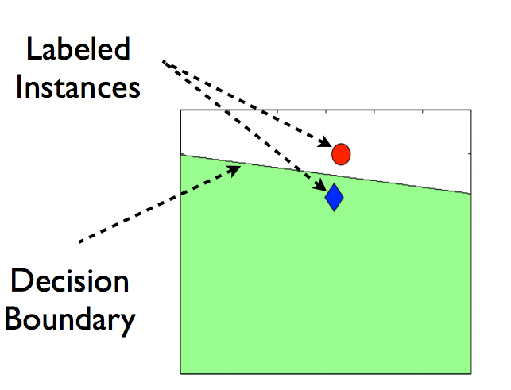
How does Semi-Supervised Learning work?
The unlabeled data can help
More precise decision boundary
More robust

Slide 14
More Precise Boundary

Slide 15
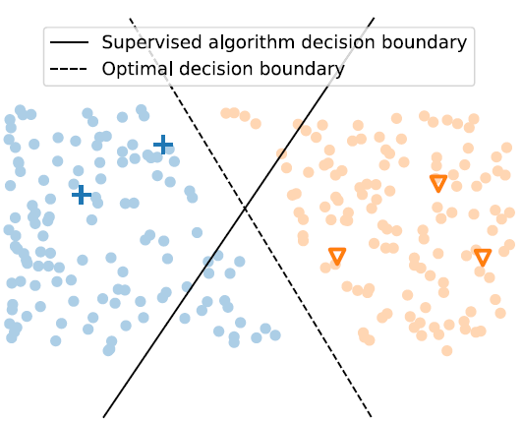
Assumptions of Semi-supervised Learning
Semi-supervised learning algorithms have the following assumptions on data
Continuity Assumption
Points closer to each other are more likely to have the same output label
Cluster Assumption
Data can be divided into discrete clusters
Points in the same cluster are more likely to share the same output label
van Engelen, J.E., Hoos, H.H. A survey on semi-supervised learning. Mach Learn 109, 373–440 (2020).

Slide 16
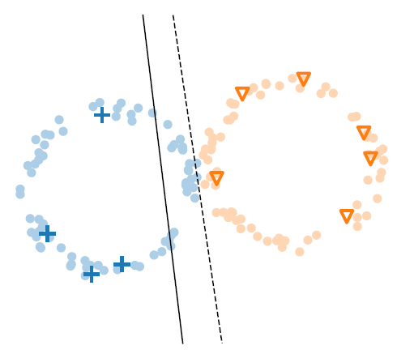
Assumptions of Semi-supervised Learning (Cont.)
Semi-supervised learning algorithms have the following assumptions on data
Manifold (Low-Dimensionality) Assumption
Data lie approximately on a manifold of (much) lower dimension than the input space
van Engelen, J.E., Hoos, H.H. A survey on semi-supervised learning. Mach Learn 109, 373–440 (2020).

Slide 17
Agenda
Data and Labels
Semi-supervised Learning
How can it work?
Assumptions
Semi-supervised Learning Methods
Self Training
Clustering and Label
Co-training
Gaussian Mixture
Graph-based Methods
Semi-Supervised Learning GAN
Semi-supervised Learning Applications
Summary

Slide 18
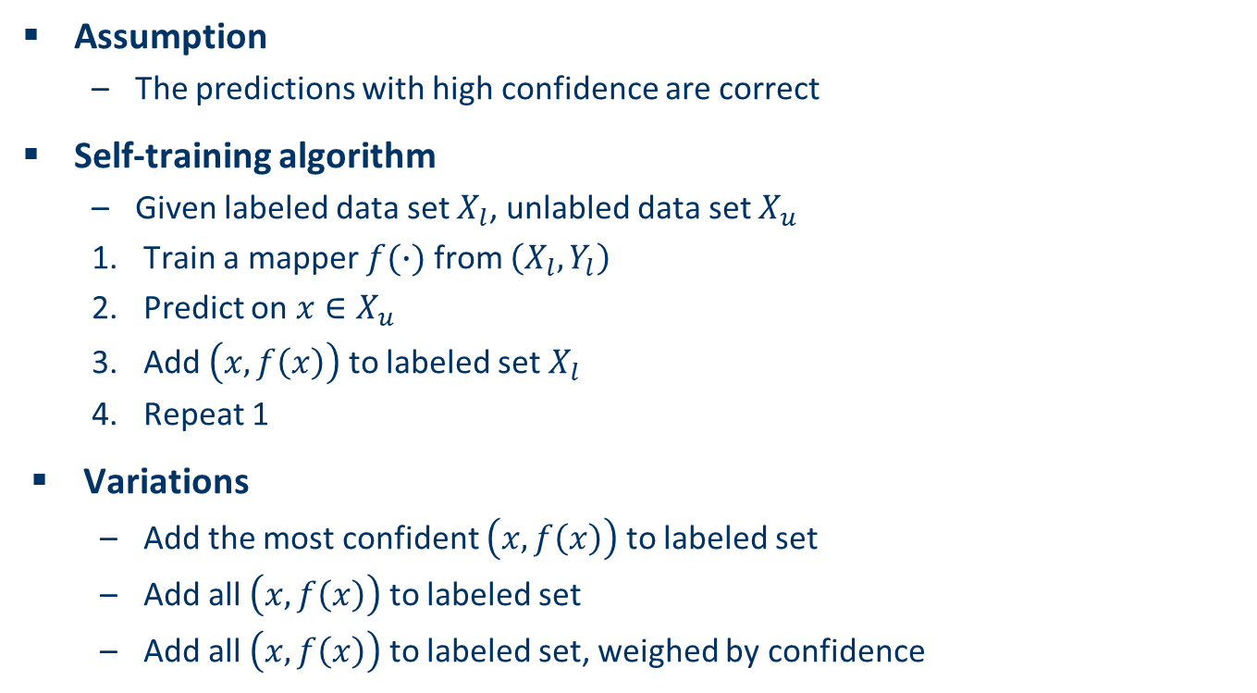
Self Training
Assumption
The predictions with high confidence are correct
Self-training algorithm
Given labeled data set $X_{l}$, unlabled data set $X_{u}$
Train a mapper $f(∙)$ from $\left(X_{l}, Y_{l}\right)$
Predict on $x∈X_{u}$
Add $\left(x, f\left(x\right)\right)$ to labeled set $X_{l}$
Repeat 1
Variations
Add the most confident $\left(x, f\left(x\right)\right)$ to labeled set
Add all $\left(x, f\left(x\right)\right)$ to labeled set
Add all $\left(x, f\left(x\right)\right)$ to labeled set, weighed by confidence

Slide 19
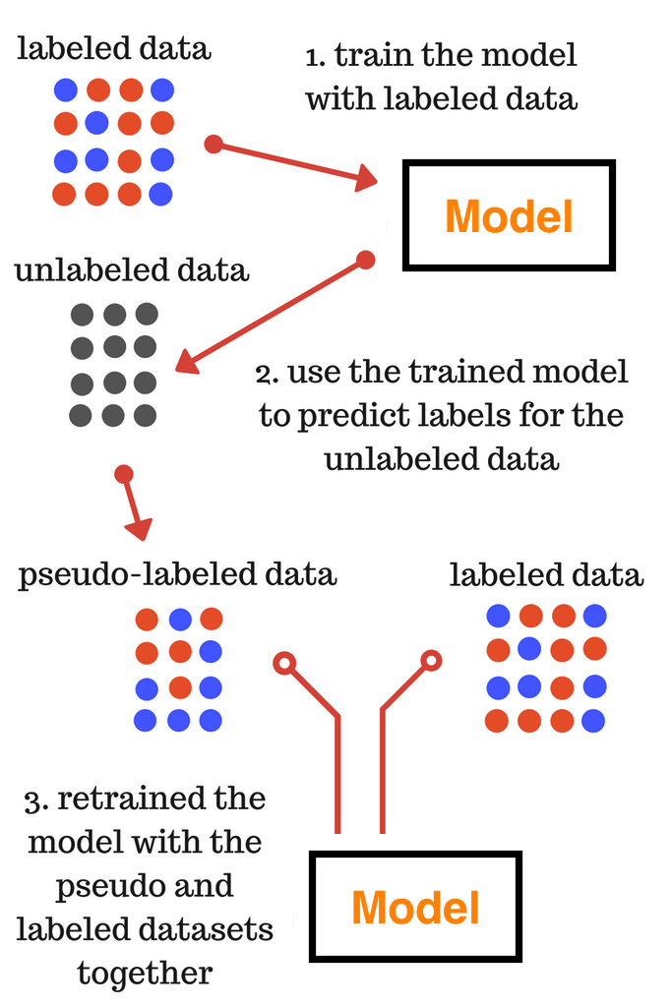
Pseudo Labeling
Pseudo Labels
Approximate labels generated by semi-supervised learning algorithms
Given to unlabeled data
Image Credit: Vinko Kodzoman

Slide 20
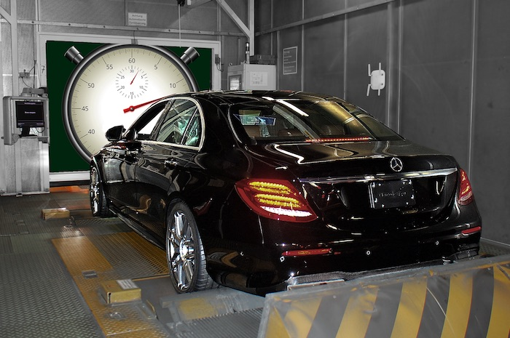
Demo: Self-Training with Pseudo Labeling on Kaggle Mercedes-Benz Greener Manufacturing Competition
Jupter notebook pseudo_labeling.ipynb
This competition is to tackle the curse of dimensionality and reduce the time that cars spend on the test bench. Competitors will work with a dataset representing different permutations of Mercedes-Benz car features to predict the time it takes to pass testing. Winning algorithms will contribute to speedier testing, resulting in lower carbon dioxide emissions without reducing Daimler’s standards.

Slide 21
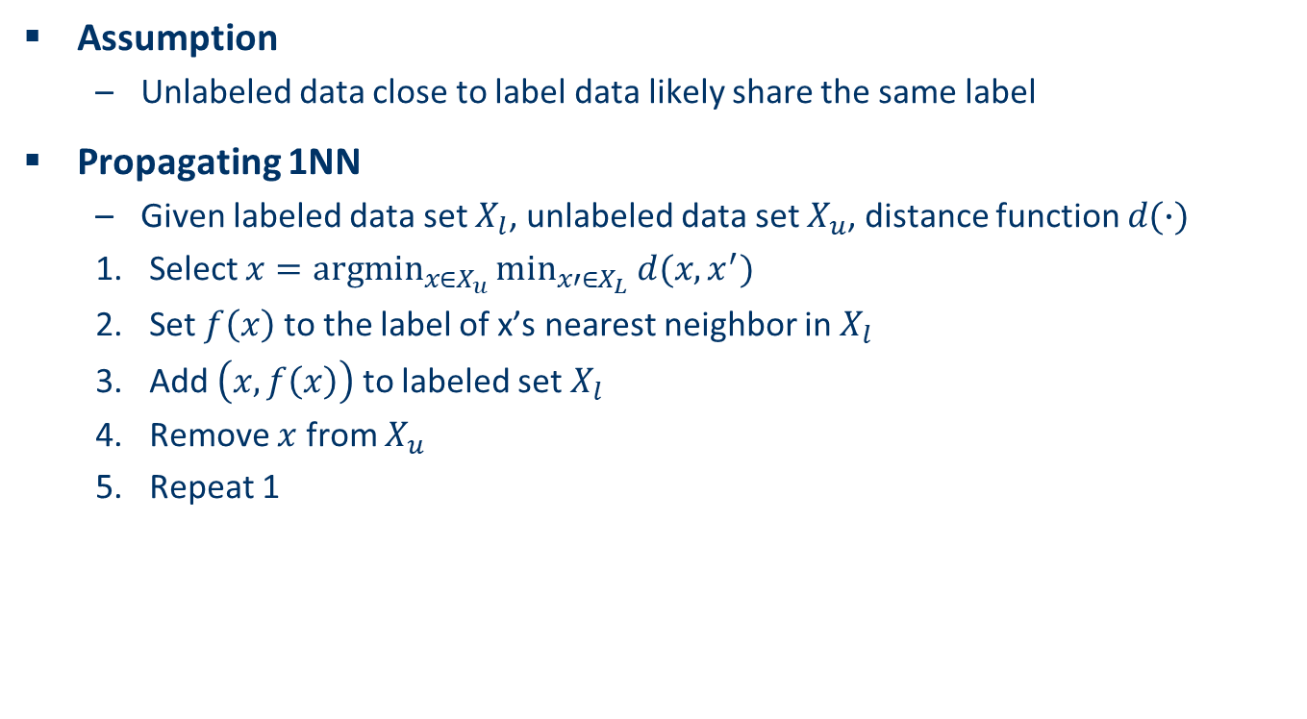
Propagating 1-Nearest Neighbor
Assumption
Unlabeled data close to label data likely share the same label
Propagating 1NN
Given labeled data set $X_{l}$, unlabeled data set $X_{u}$, distance function $d(∙)$
Select $x=\underset{x∈X_{u}}{argmin}{\min_{x′∈X_{L}}{d(x, x^{′})}}$
Set $f\left(x\right)$ to the label of x’s nearest neighbor in $X_{l}$
Add $\left(x, f\left(x\right)\right)$ to labeled set $X_{l}$
Remove $x$ from $X_{u}$
Repeat 1

Slide 22
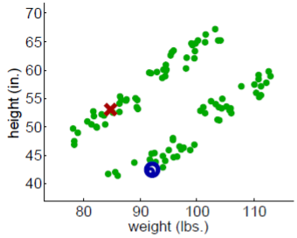
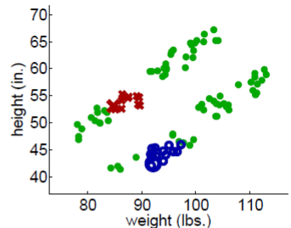
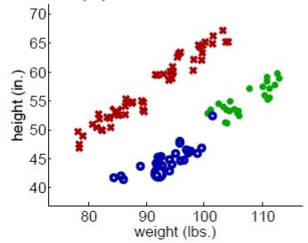
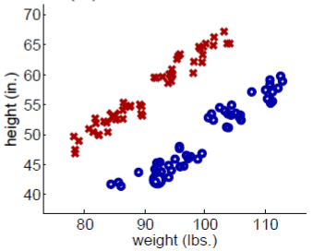
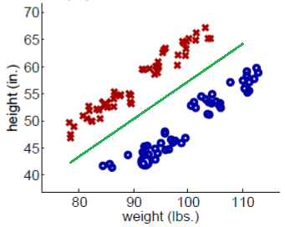
Example of propagating 1NN
Initialization
After 25 iterations
After 74 iterations
All unlabeled samples are set
Find decision boundary
Figure Source: Barnabas Poczos

Slide 23
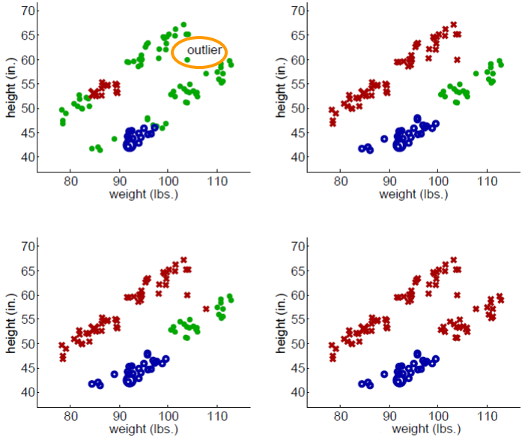
Problem of Propagating 1NN
Sensitive to outliers
Figure Source: Barnabas Poczos

Slide 24
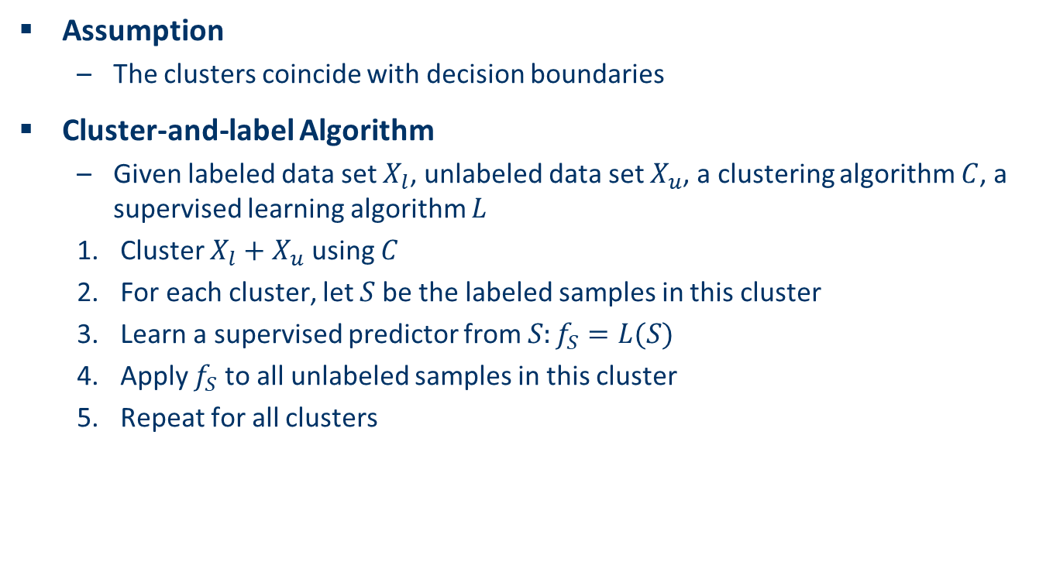
Cluster-and-label Method
Assumption
The clusters coincide with decision boundaries
Cluster-and-label Algorithm
Given labeled data set $X_{l}$, unlabeled data set $X_{u}$, a clustering algorithm $C$, a supervised learning algorithm $L$
Cluster $X_{l}+X_{u}$ using $C$
For each cluster, let $S$be the labeled samples in this cluster
Learn a supervised predictor from $S:f_{S}=L(S)$
Apply $f_{S}$ to all unlabeled samples in this cluster
Repeat for all clusters

Slide 25
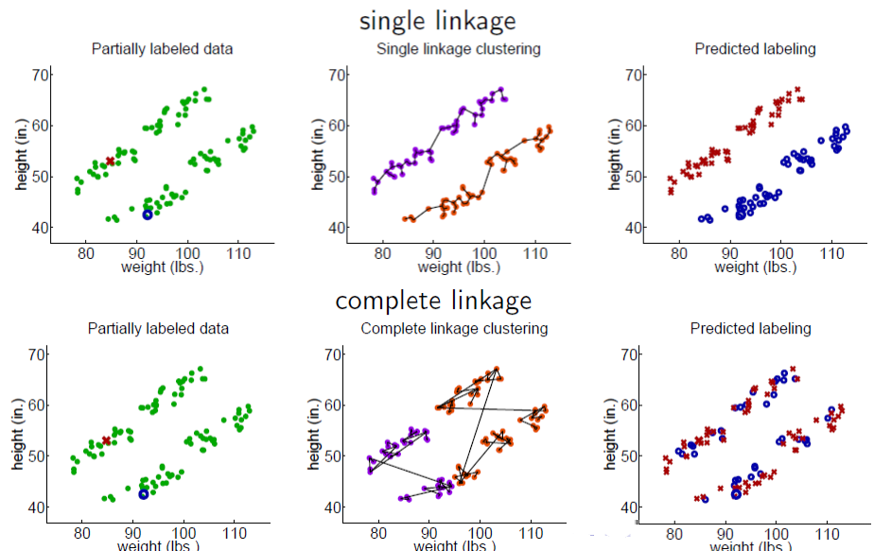
Cluster-and-label Method
Sensitive to the clustering algorithm
Figure Source: Barnabas Poczos

Slide 26
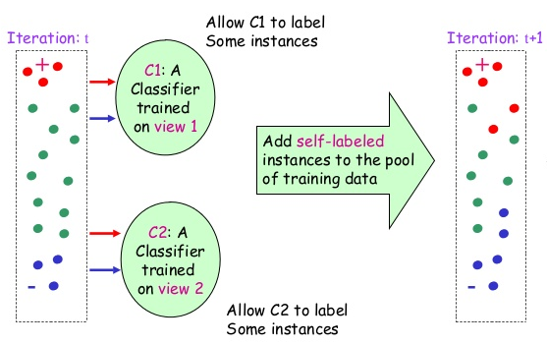
Co-Training (Multi-View Algorithm)
Co-training
An extension of self-training
Multiple supervised classifiers
Iteratively trained on the labeled data
Adding the most confident predictions to the other classifiers
Key to success
The supervised classifiers must not be strongly correlated
Yarowski Algorithm

Slide 27
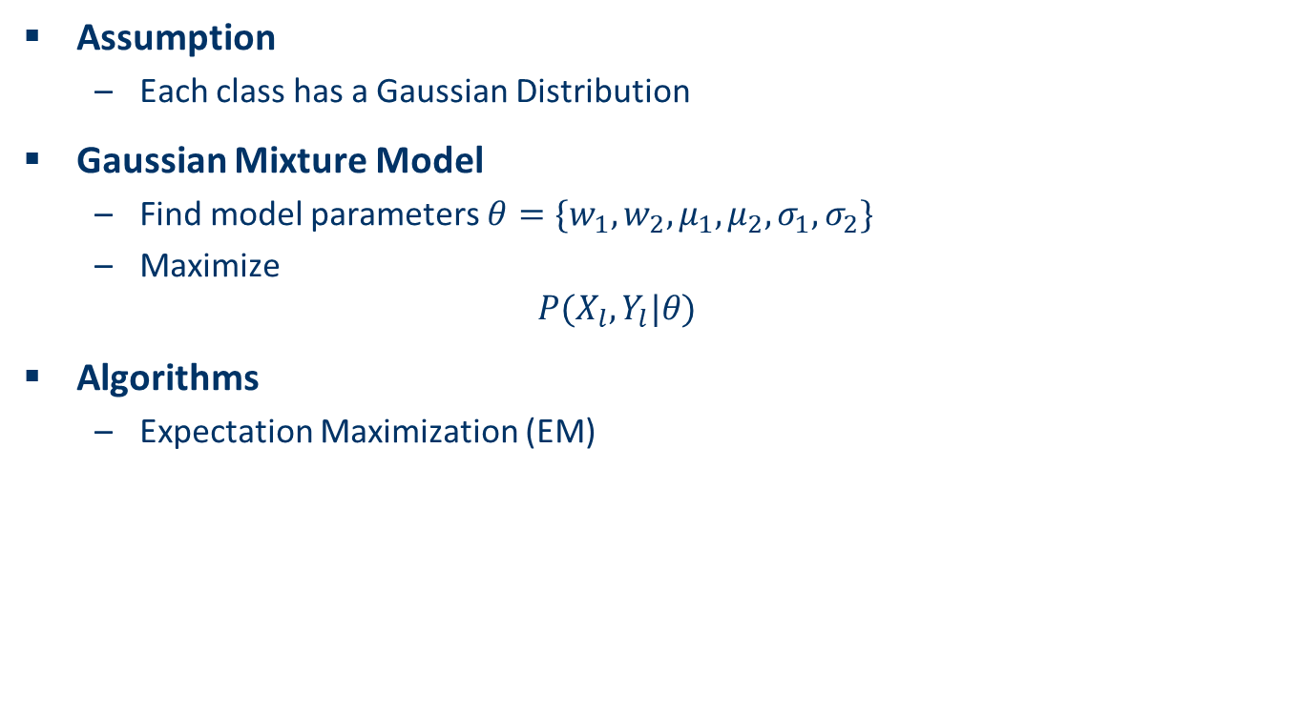
Gaussian Mixture Model
Assumption
Each class has a Gaussian Distribution
Gaussian Mixture Model
Find model parameters $θ=\{w_{1},w_{2},μ_{1},μ_{2},σ_{1},σ_{2}\}$
Maximize
$$P(X_{l},Y_{l}|θ)$$
Algorithms
Expectation Maximization (EM)

Slide 28
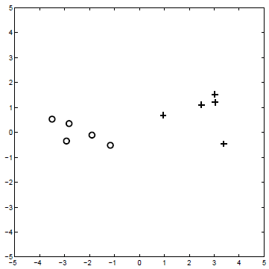
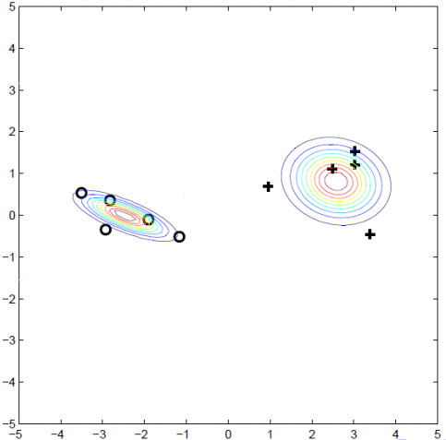
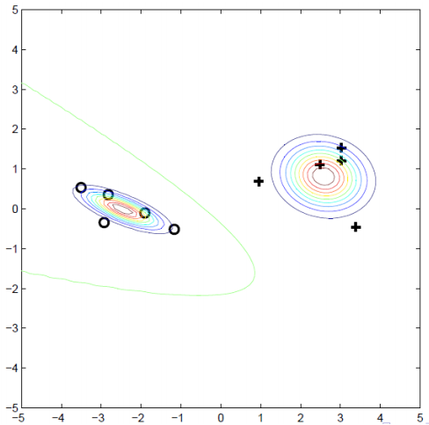
Gaussian Mixture Model
Given Labeled Data
Most Likely Gaussians
Decision Boundary

Slide 29
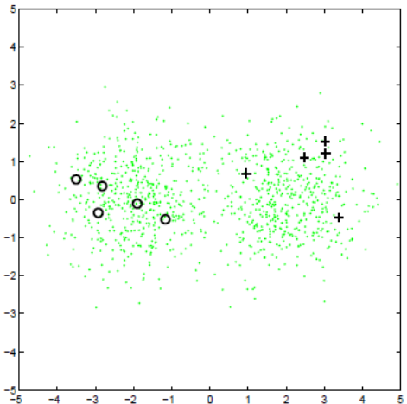
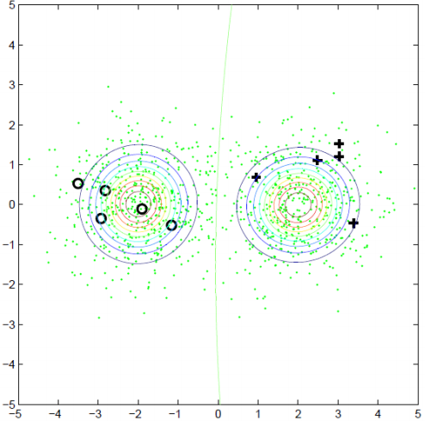

Semi-Supervised Gaussian Mixture Model
Maximize
$$P(X_{l},Y_{l},X_{u}|θ)$$

Slide 30
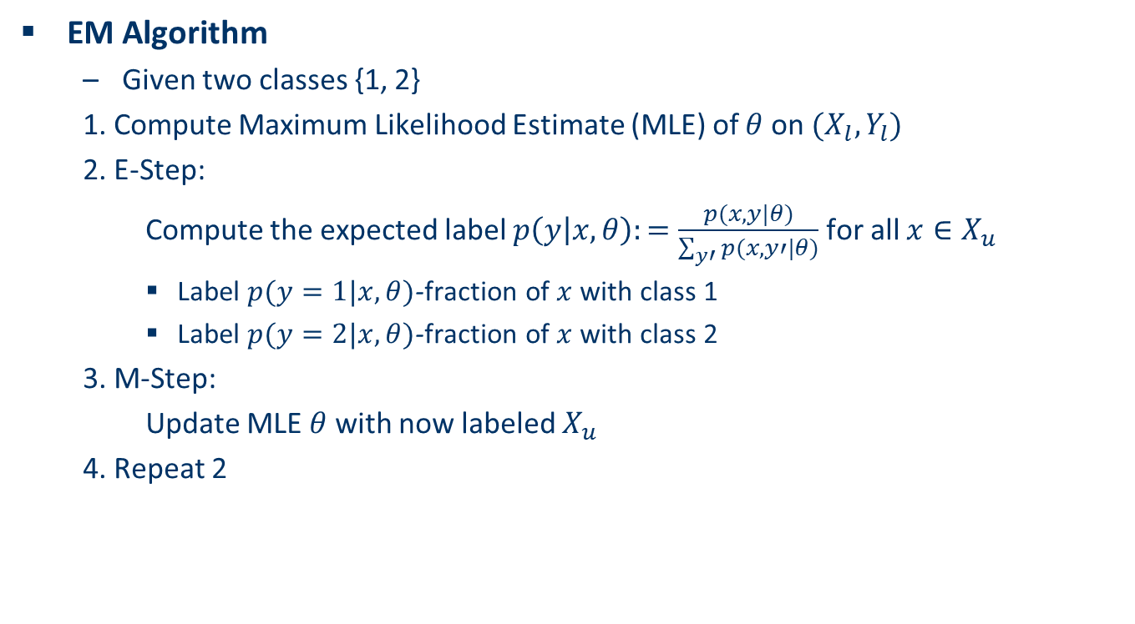
Expectation-Maximization (EM) for Semi-supervised Gaussian Mixture Model
EM Algorithm
Given two classes {1, 2}
1. Compute Maximum Likelihood Estimate (MLE) of $θ$ on $(X_{l},Y_{l})$
2. E-Step:
Compute the expected label $p\left(y | x,θ\right):=\frac{p(x, y|θ)}{\sum_{y′}{p(x, y′|θ)}}$ for all $x∈X_{u}$
Label $p(y=1|x, θ)$-fraction of $x$ with class 1
Label $p(y=2|x, θ)$-fraction of $x$ with class 2
3. M-Step:
Update MLE $θ$ with now labeled $X_{u}$
4. Repeat 2

Slide 31
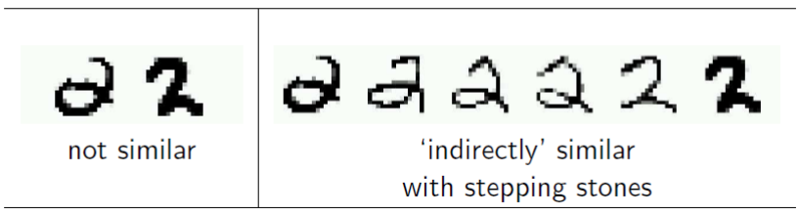
Graph-based Methods
Assumption
Similar unlabeled data have similar labels
Example in handwritten digit recognition

Slide 32
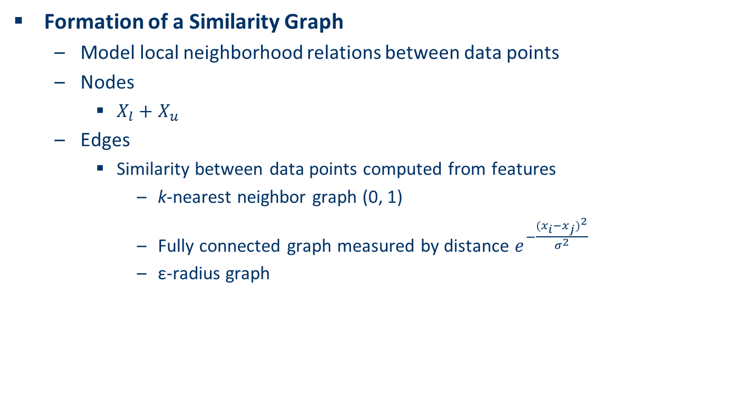
Similarity Graph
Formation of a Similarity Graph
Model local neighborhood relations between data points
Nodes
$X_{l}+X_{u}$
Edges
Similarity between data points computed from features
k-nearest neighbor graph (0, 1)
Fully connected graph measured by distance $e^{−\frac{{(x_{i}−x_{j})}^{2}}{σ^{2}}}$
ε-radius graph

Slide 33
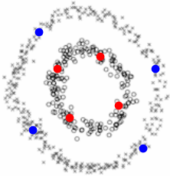
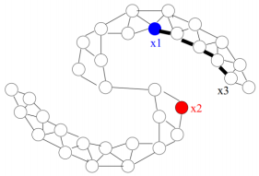
Graph Regularization Methods
Assumption
Nodes connected by heavy edges tend to share similar label

Slide 34

Graph Regularization Methods
Fundamental Idea
If data points i and j are similar with high connected weights, their labels are similar
$$\min_{f}{\sum_{x_{i}∈X_{u}}{{\left\|f\left(x_{i}\right)−y_{i}\right\|}^{2}}+λ}\sum_{x_{i},x_{j}∈X_{u}∪X_{l}}{w_{ij}{\left\|f\left(x_{i}\right)−f\left(x_{j}\right)\right\|}^{2}}$$
Loss on labeled data
Graph regularization on labeled and unlabeled data

Slide 35
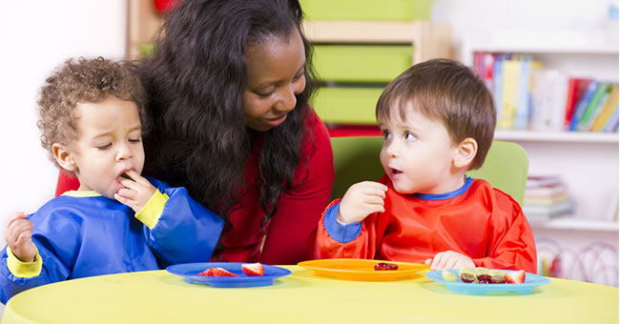
Semi-supervised Learning GAN
Inspired from Human Learning
Training Deep Neural Networks
Requires a lot of samples
Image classification requires 3.2M images in ImageNet
Teaching a young kid (concept learning)
Just a few samples
Parents say “dog” by pointing to a dog
A lot of unlabeled samples
Seeing a lot of other “dogs”
Semi-supervised Learning GAN
Train a GAN with labeled and unlabeled samples

Slide 36
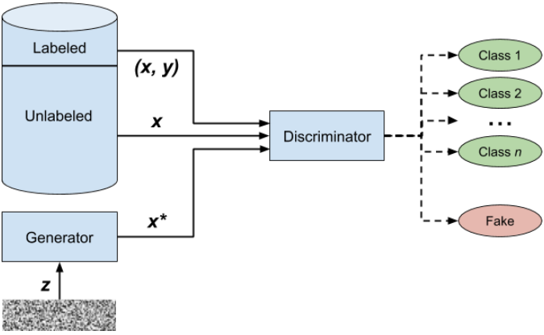
Architecture of Semi-Supervised Learning GAN
Semi-Supervised Learning GAN
Generator
Input
Noise z
Output
Fake samples x*
Discriminator
Input
Fake samples x*
Real unlabeled samples x
Real labeled samples (x, y)
Output
Distinguish x* from real samples
Classify Real labeled samples
Image source: GANS in action

Slide 37
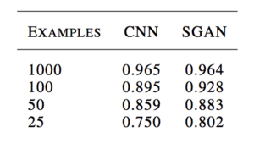
GAN-based Semi-Supervised Learning
Semi-supervised learning GAN can learn effectively from small number of samples
Augustus Odena, “Semi-Supervised Learning with Generative Adversarial Networks,” 2016.

Slide 38
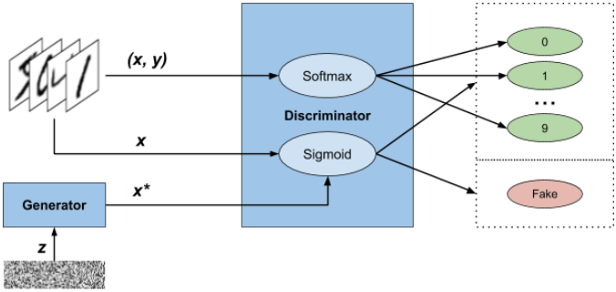
Demo: GAN-based Semi-supervised Learning
Jupyter notebook SemiSupervisedGAN.ipynb

Slide 39
Agenda
Data and Labels
Semi-supervised Learning
How can it work?
Assumptions
Semi-supervised Learning Methods
Self Training
Clustering and Label
Co-training
Gaussian Mixture
Graph-based Methods
Semi-Supervised Learning GAN
Semi-supervised Learning Applications
Summary

Slide 40
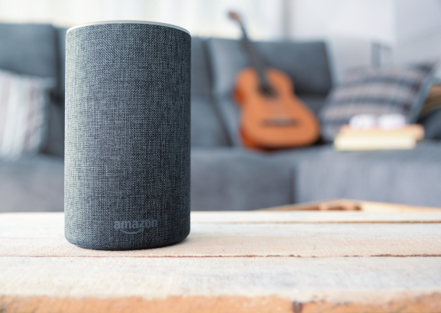
Speech Recognition
“Alexa AI scientists reduce speech recognition errors up to 22% with semi-supervised learning”
7,000 hours training on labeled data
1,000,000 hours training on unlabeled data
“one of the largest unlabeled data sets ever assembled to train an acoustic model”
https://venturebeat.com/2019/04/04/alexa-ai-scientists-reduce-speech-recognition-errors-up-to-22-with-semi-supervised-learning/

Slide 41
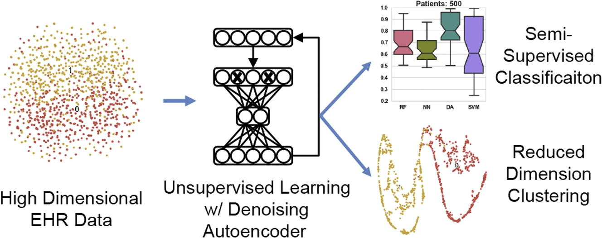
Semi-Supervised Learning in Electronic Health Records
Semi-supervised learning helps clarify disease subtypes and improve genotype-phenotype association
Brett K. Beaulieu-Jones, Casey S. Greene, Semi-supervised learning of the electronic health record for phenotype stratification, Journal of Biomedical Informatics, 2016.

Slide 42
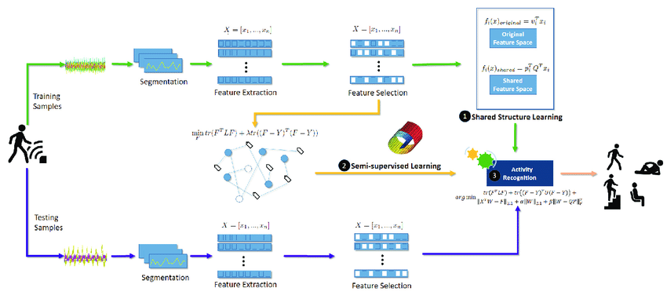
Human Activity Recognition
Semi-supervised learning can enhance human activity recognition accuracy with a lot of real-time collecting unlabeled data
Lina Yao, Feiping Nie, Quan Z. Sheng, Tao Gu, Xue Li, and Sen Wang. 2016. Learning from less for better: semi-supervised activity recognition via shared structure discovery, UbiComp16.

Slide 43
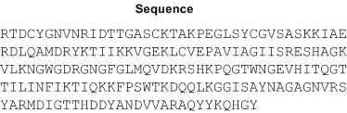











Modeling Protein Structures
Yaohang Li, Ph.D.
Department of Computer Science
Old Dominion University
yaohang@cs.odu.edu

Slide 44

Outlier Detection using Semi-Supervised Learning
A few labeled normal data
A few labeled outliers
A lot of unlabeled data
Lukas Ruff, Robert A. Vandermeulen, Nico Görnitz, Alexander Binder, Emmanuel Müller, Klaus-Robert Müller, Marius Kloft, “Deep Semi-Supervised Anomaly Detection,” ICLV, 2020.

Slide 45
Summary
Data and Labels
Labeled data are often rare, expensive, and hard to get
Unlabeled data are often abundant and easy to obtain
Semi-supervised Learning
Unlabeled data can help
Semi-supervised learning has a lot of practical applications
When a lot of unlabeled data is available

